Slide 1

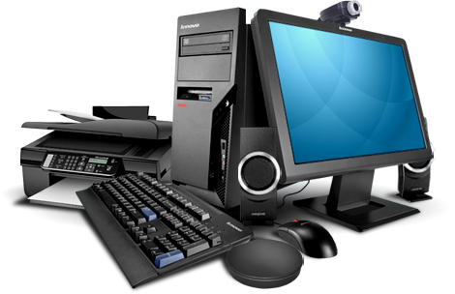


Computer
Hardware
Class V
lab 1

Slide 2
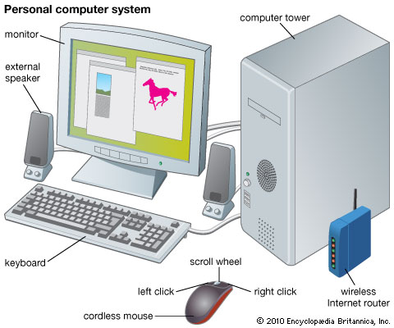
Computer System

Slide 3
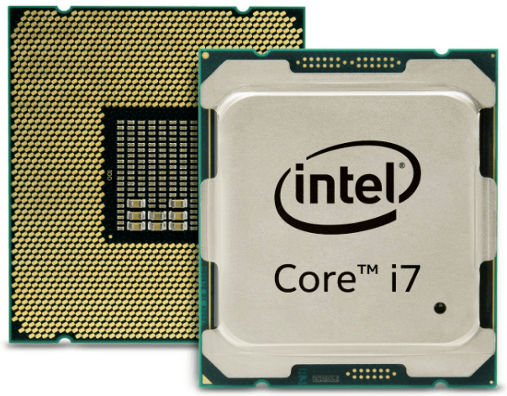
Computer Processor
a small chip that receives input and provides the appropriate output

Slide 4
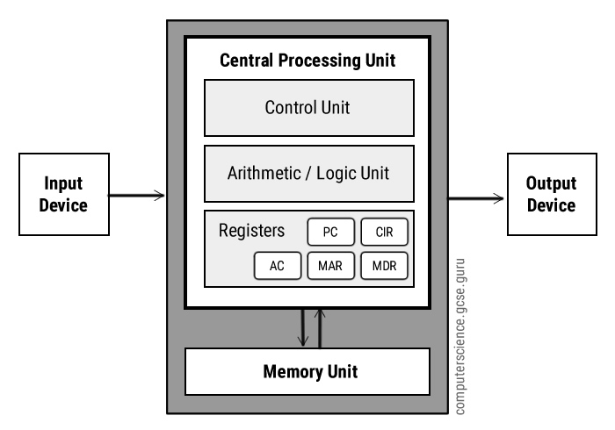
Computer Architecture
It refers to how a computer system is designed and what technologies it is compatible with

Slide 5
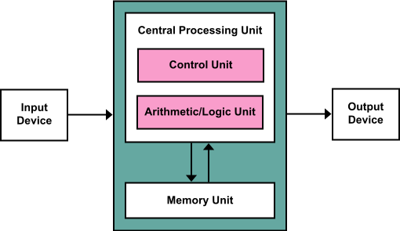
Arithmetic Logic Unit
It processes arithmetic and logic operations that need to be done on instruction words

Slide 6
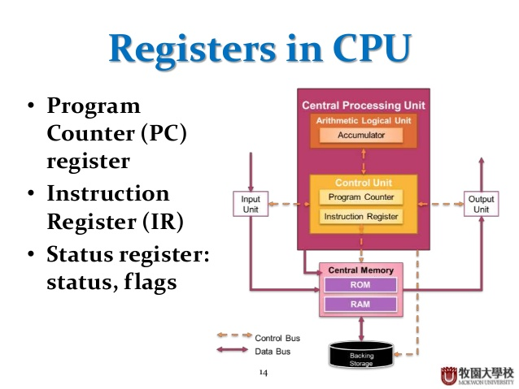
Registers
Register is a very fast computer memory, used to store data/instruction in-execution

Slide 7
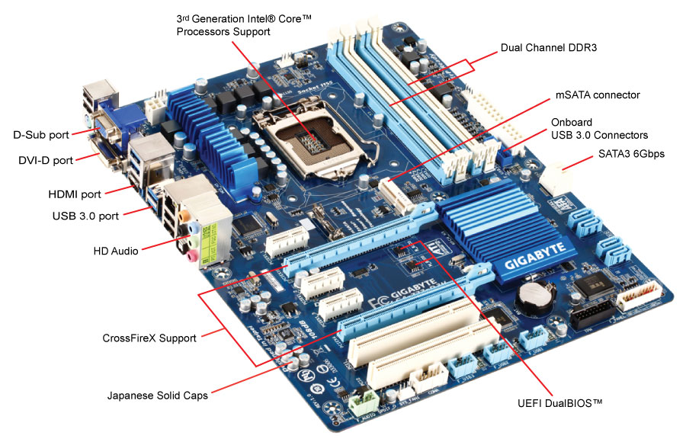
Motherboard
It holds CPU, memory and all typess of connector for input and output devices

